Slide 1
Predicting the Presence of Cancer in Breast Cancer Cells
Gustavo “David” Reyes, Kenny Rodriguez, Bryan Rojas, and MacKenzie Wright
Notes:
MacKenzie

Slide 2
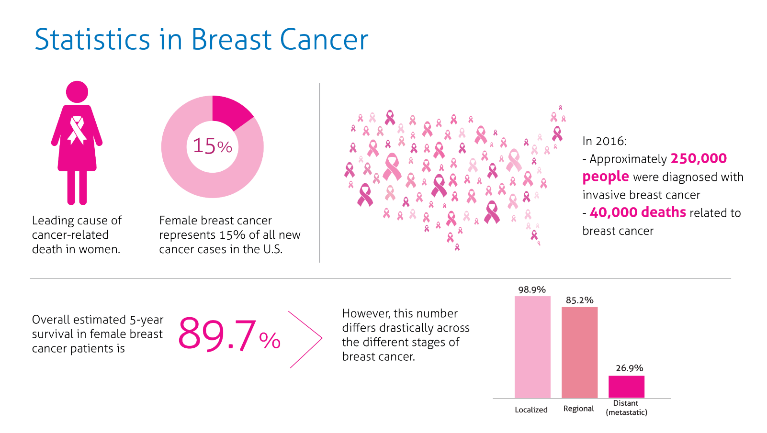
The Use of Machine Learning to Predict the Presence of Breast Cancer
Why did we pick this topic?
Breast cancer is the one of the most common cancers among women. The American Cancer Society estimates about 287,850 new cases of invasive breast cancer will be diagnosed in the United States during the year 2022.
https://magellanhealthinsights.com/2018/10/09/october-is-national-breast-cancer-awareness-month/
Breast cancer statistics: How common is breast cancer? American Cancer Society. (n.d.). Retrieved May 20, 2022, from https://www.cancer.org/cancer/breast-cancer/about/how-common-is-breast-cancer.html
Notes:
MacKenzie
Breast cancer is the most common type of cancer in women following skin cancer.
About 30% or 1 in 3 women with new cases of cancer will be diagnosed with breast cancer. In the year 2022, 287,850 new cases of invasive breast cancer will be diagnosed in the United States.
The reason why breast cancer is deadly is the relative closeness to the lymph nodes found in the armpits. If the cancer cells spread to the lymph nodes, they can easily spread throughout the body using the lymphatic and vascular system.

Slide 3
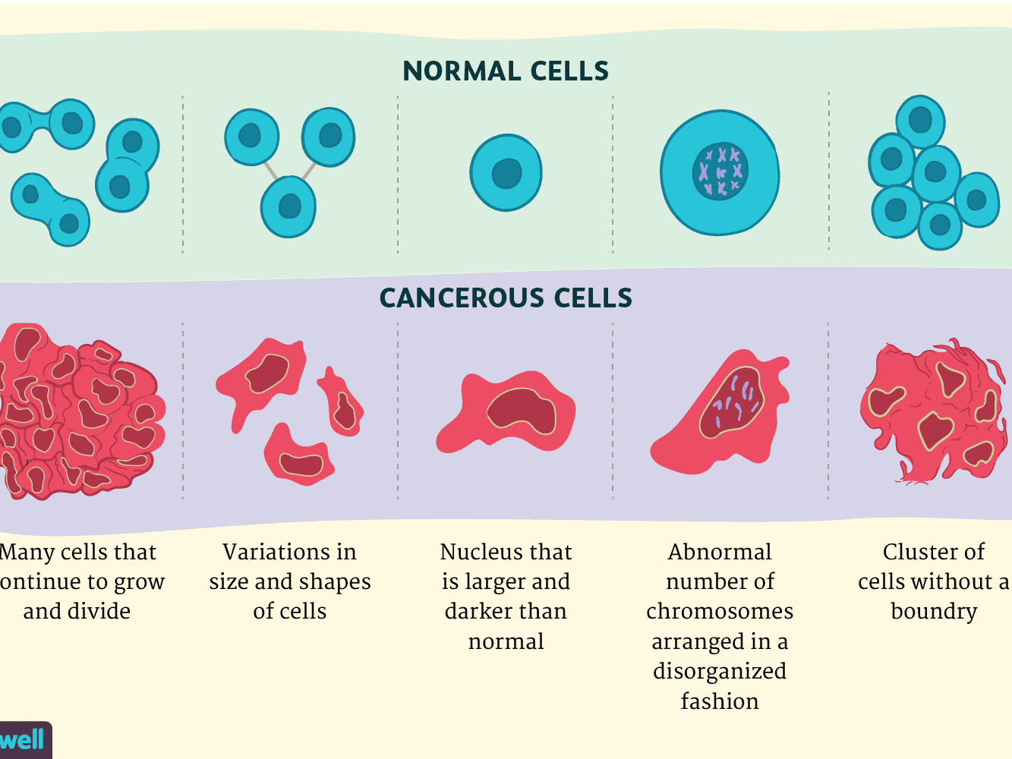
let’s have a quick biology lesson…
Before we begin,
Before moving forward, it is important to cover a few details about tumor cells and how they’re distinguishable from normal healthy cells.
Tumors, benign or malignant, are abnormal cells who’ve undergone several changes in order to achieve the ability to grow outside of a normal cells restraints.
In other words, one mutated cell does not equal cancer, but rather a list of mutations in multiple cell generations is what causes tumorous tissue.
https://www.verywellhealth.com/cancer-cells-vs-normal-cells-2248794
Notes:
MacKenzie
Before we get into the analysis part, let’s discuss what would actually be considered cancer.
A person can have a tumor, but it does not necessarily mean they have cancer; the tumor can either be benign or malignant. Benign meaning it is not cancerous and malignant meaning it is cancerous.
A tumor are normal cells who have gone through several changes in order to achieve the ability to grow outside its normal restraints.
Simply put, one mutated cell does not mean mean it is cancer; there are other factors involved in the cells mutation over several generations that would lead to the cell to grow into cancerous tissue.

Slide 4
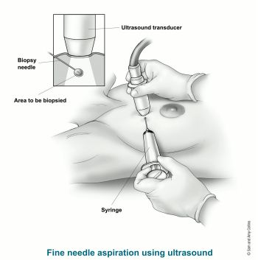
Our Data
Samples are collected using an FNA (fine needle aspiration) for individuals with suspected tumors.
Measures of the cells from each sample are tested by collecting:
Radius, Texture, Perimeter, Area, Smoothness, Compactness, Concavity, Concave Points, Symmetry, and Fractal Dimension
https://www.cancer.org/cancer/breast-cancer/screening-tests-and-early-detection/breast-biopsy/fine-needle-aspiration-biopsy-of-the-breast.html
Notes:
MacKenzie
Our dataset consists of measurements taken of cells using FNA, or fine needle aspiration, from people with suspected tumors.
The image to the right shows how each sample would have been taken from each patient using this method.
The ultrasound would locate the tumor within the breast tissue and then be used to guide the needle to the desired location to acquire the sample.
The measurements that were focused on were Radius, Texture, Perimeter, Area, Smoothness, Compactness, Concavity, Concave Points, Symmetry, and Fractal Dimension
Radius = mean of distances from center to points on the perimeter
Texture = standard deviation of gray-scale values
Perimeter = the distance around the edge of a shape of the cell.
Area = area based on the cell’s perimeter
Smoothness = local variation in radius lengths
Compactness = perimeter^2 / area - 1.0
Concavity = severity of concave portions of the contour
concave points = number of concave portions of the contour
Symmetry = cell symmetry based on mean radius
fractal dimension = ( a measure of the space-filling capacity of a pattern that tells how a fractal scales differently from the space it is embedded in.) “coastline approximation” - 1
These values were computed by the using the images from each sample. We inherited the data after it was manipulated to reflect the mean of each measure, the standard error, and the mean of the largest or “worst” of these features. This process was surely to create a standardization of the values since each measure would have a different standard of measurement.

Slide 5

Goals
The goal of our analysis is to apply the power of machine learning models to identify the likelihood that a tumor could either be benign or malignant. To accomplish this, we first need to answer the following questions:
Which features have the greatest likelihood of predicting malignancy?
How should the data be structured in order to test?
What machine learning model would best predict breast cancer malignancy?
Notes:
Bryan
Read the slide

Slide 6
Recount of Technologies, Tools, Languages, and Algorithms
Machine Learning Model: Google Colab - Python, Pandas, PySpark, and Matplotlib/Seaborn
For ease of sharing amongst all four members, we used Google Colab to write and build our Machine Learning Model. This allowed us to easily upload the DataBase through the cloud easier with Amazon Web Services (AWS).
DataBase: AWS - RDS and S3 & Postgres
The AWS was used to easily add the DataBase to our notebook. With AWS, we connected to the Database locally with Postgres to create the tables we used for this model. After the tables were created, we loaded them back to AWS, which can then be added to our notebook on Google Colab
Interactive Visualization: Tableau
For the dashboard we created, we used Tableau to create a drop down menu of the different graphs we created in order to allow the user to have a better grasp of how different features affect the diagnosis of the patient’s sample.
Notes:
Bryan
Machine Learning Model:
For our machine learning model, we used Google Colab. As you guys already know, you can share your Google Colab notebooks very easily. Additionally, there was no need to install any modules to run any code, as modules come pre installed within Google Colab. By using the computing power of the Google servers instead of our own machine we didn’t to worry about our local machine performance.
Languages
In order to build our machine learning model, we used Python. Within Python, we used Pandas, PySpark, and Matplotlib.
· Pandas is a software library written for the Python programming language for data manipulation and analysis. We used pandas to load a CSV file with all the data we were planning to analyze directly into our notebook. From there we were able to create tables and data frames to conduct our analysis.
· PySpark is a Python-based API for utilizing the Spark framework in combination with Python. PySpark is primarily used for processing structured and semi-structured datasets. We used PySpark to load data from Amazon Web Services into our notebook via the cloud. Very much like Pandas, we were able to create schemas to visualize the data in table formatting.
· Lastly, Matplotlib and Seaborn are programs that allowed us to create visualizations of our analysis so we could further comprehend what the data was telling us. The visual graphs and charts used in our presentation are on the next page.

Slide 7
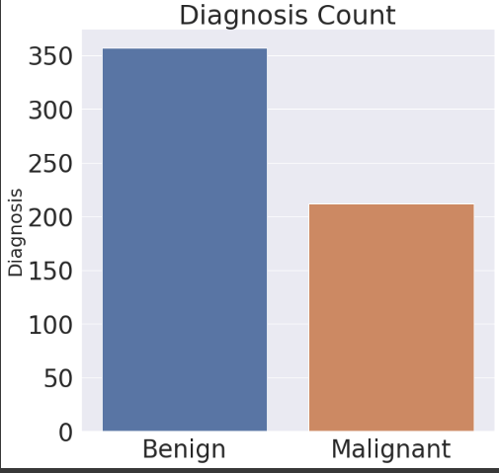
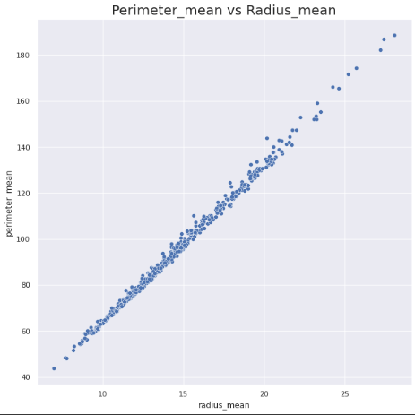
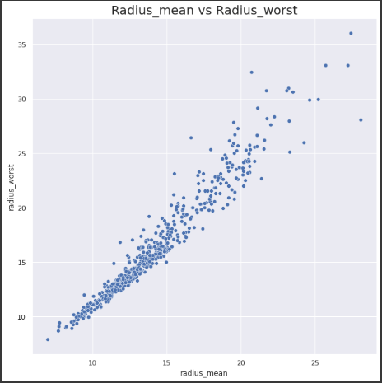
Exploratory Analysis Cont.
Perimeter Mean vs Radius Mean
Benign Tumors vs Malignant Tumors
Radius Mean vs Radius Worst
Notes:
Bryan

Slide 8
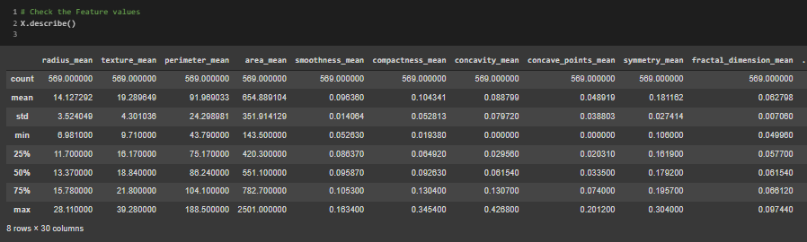
Exploratory Analysis
Notes:
Bryan
Our initial exploratory analysis demonstrated a correlation between certain features within our dataset. By recognizing patterns in our dataset, we were able to identify what columns to test using a linear regression model. The linear regression model yielded promising results, therefore, the model evolved into a logistical regression model that would test all the features in our dataset. All of which are shown here.

Slide 9
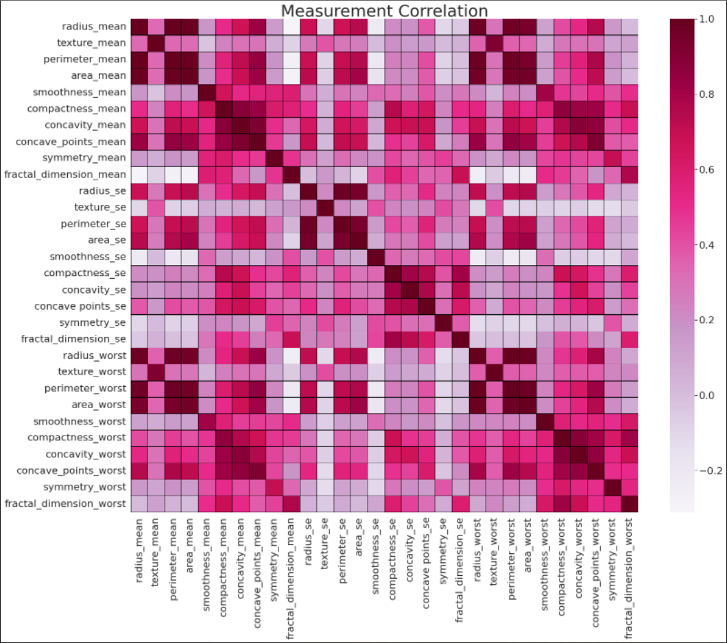
Exploratory of our Data
A benign tumor has distinct, smooth, regular borders. A malignant tumor has irregular borders and grows faster than a benign tumor.
Using Seaborn and Matplotlib, we were able to infer that feature to focus on using a heatmap.
The results draw our attention to the hot spots were we can eliminate features that are vs themselves, since those would clearly have a high correlation.
Here’s a list of the tables we will build using what we found from the heatmap:
Perimeter mean vs Radius mean
Perimeter mean vs Radius worst
Perimeter mean vs Area mean
Perimeter mean vs Area worst
Radius mean vs Area worst
Area mean vs Radius mean
All values along the cyan line are negligible since all these values are the result of each feature against itself.
Notes:
Kenny
The figure to the right provides the correlation of all our features against themselves by shading does of high correlation closer to the color Purple and those with less correlation white or light red.
From looking at the heat map, we created tables based off the features that have the features that correlate with each other the most

Slide 10
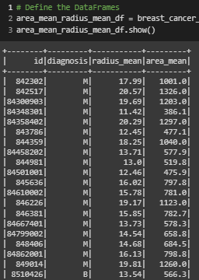
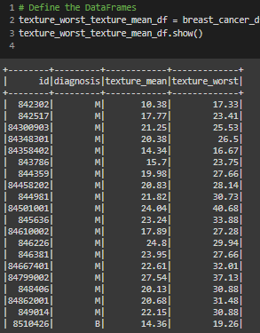
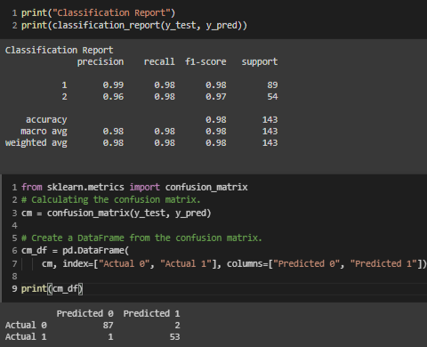
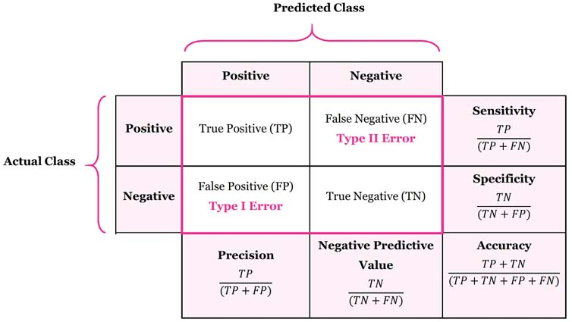
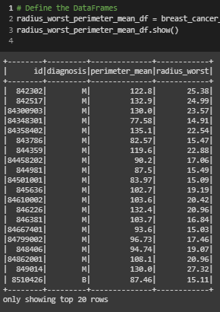
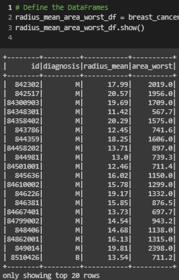
Exploratory of our Data
The values we’ve measured have presented incredibly accurate results. Further evaluation of other features may need to performed to assess the sensitivity of the machine learning model.
Classification Report
Confusion Matrix
With the above results being so high in each field, our goal was to further test our model using some of the techniques covered during our machine learning module to assess the sensitivity, accuracy, and precision.
Also, the number of testing samples appears too small. We hope to address this by trying oversampling to see resilient our model is.
Notes:
Kenny
Within the confusion matrix, the positive prediction, labeled 0, is malignant tumor and negative is a benign tumor, labeled 1.
After running the classification report and the confusion matrix, we can see that the model was extremely accurate across all the fields. From there, we ran our accuracy scores.

Slide 11
Interactive Dashboard
Interactive Tableau Dashboard
Notes:
Kenny

Slide 12
What we learned from our Machine Learning Model…
We ran both a Linear and Logistic Regression Models to determine which was better for predicting cancer based off the list of features provided.
For the Linear Regression, we achieved an 84.27% accuracy score which is considered acceptable.
For Logistic Regression, we received a 97.09% accuracy score meaning that a Logistic Regression is a very reliable model to use to predict whether someone has cancer based off the list of features we have provided the model.
Notes:
Kenny
Read slide
Unsure why our accuracy score for the logistic regression accuracy score was so high, we put our heads back together to try and determine what exactly in our data was leading our model to be so accurate.

Slide 13
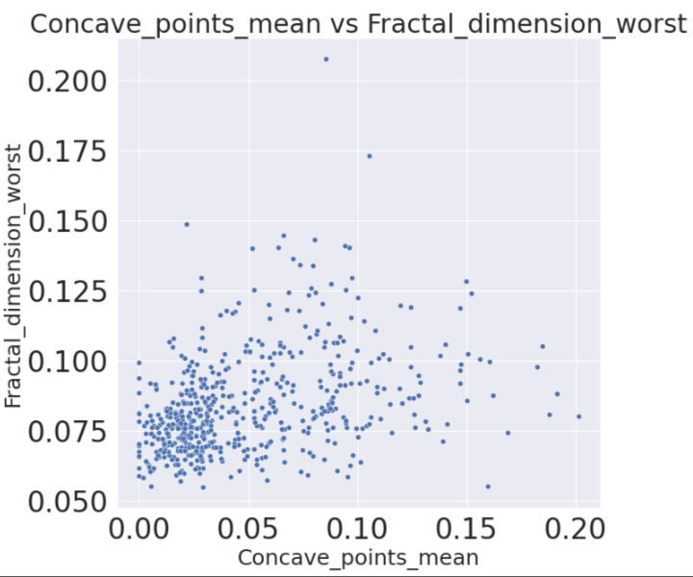
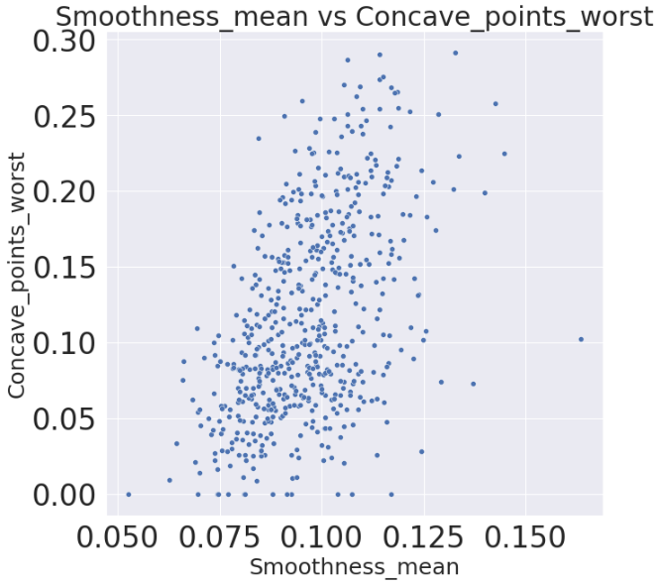
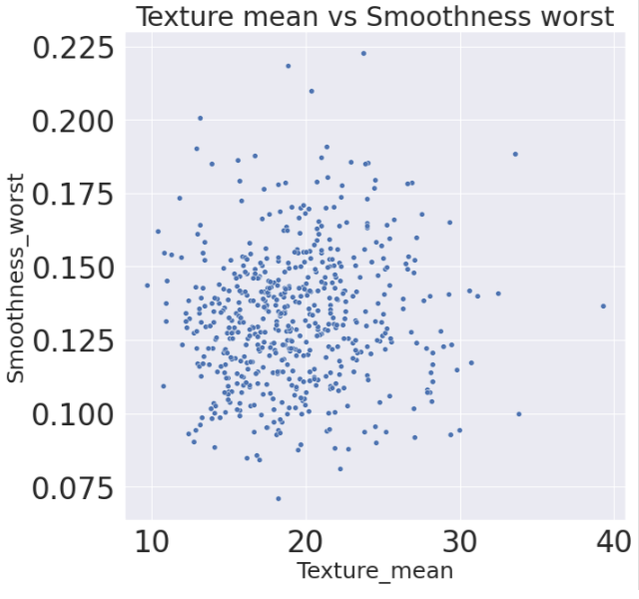
Inspecting the unexpected…
Linear Regression = 84.27%
Logistic Regression = 97.09%
Where do we go from here?
Notes:
David
I’ll be discussing our teams secondary exploratory analysis we performed along with the results of our second ML run through.
So first, our initial Machine learning models did performed a lot better than we expected. We did not anticipate such a high accuracy score.
Reviewing our data, we began to address some patterns like the cell size features, which would have a strong correlation to one-another; i.e., Area can be derived from the perimeter, and the Radius can be derived from the Area of the cell.
Reference Slide ‘8’ where we had the two visualizations in the center and the right: they were created from those features.
Discuss Visualizations:
No-correlations or visible regression lines: Concave points vs Fractional dimension worst and Texture mean vs Smoothness worst
Possible regression line but unknown pattern: Smoothness mean vs concave points worst

Slide 14
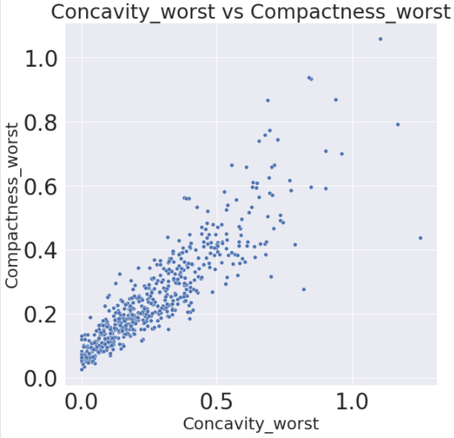
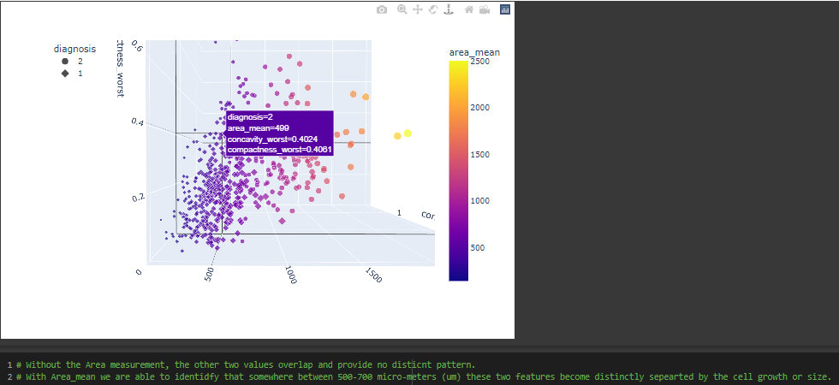
Understanding our Data: Does size really matter?
Y = Concavity_worst
Z=Compactness_worst
X = Area_mean
Notes:
David
Does Size really matter?
This is what our team began to ask as we began to look over our results.
When cells mutates, or proteins denature, the growth of the cell becomes unstable.
Thus, the size of a cell is a strong predictor for malignancy.
The second exploratory analysis focused on 3D visualizations that compared non-size related features and compared them to one size feature to compare to a 2D model.

Slide 15
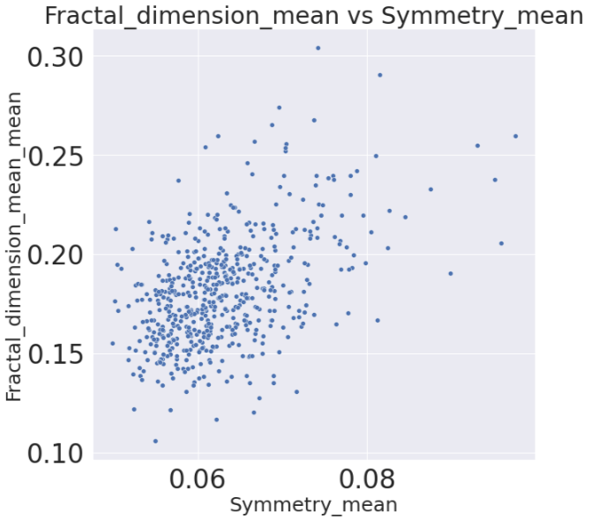
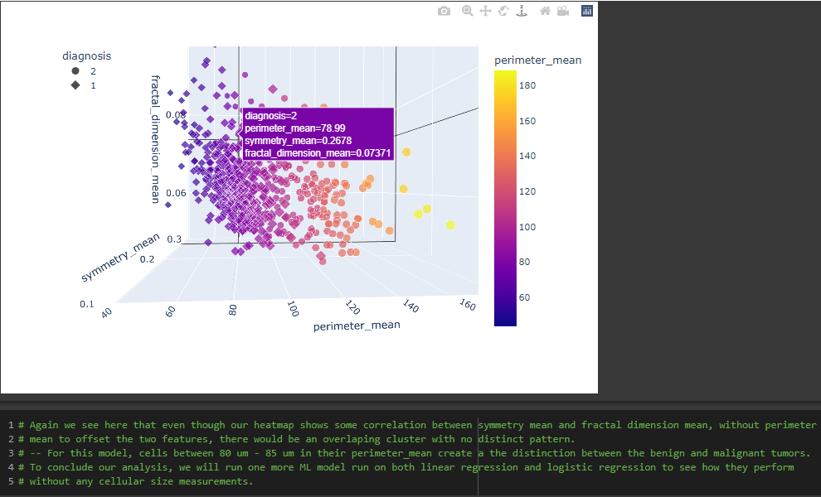
Understanding our Data
Size makes a difference; so what would happen if we removed them from our model?
Notes:
David
3D visual vs 2D; here the clusters are less defined and therefore the perimeter_mean feature helps provide guidance between malignant tumors and benign.

Slide 16
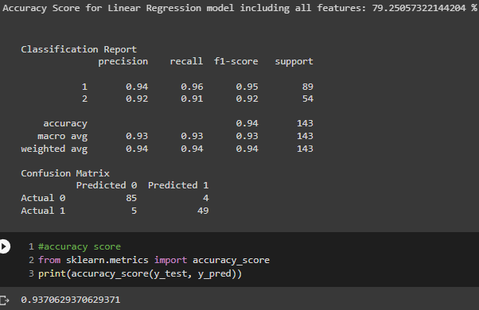
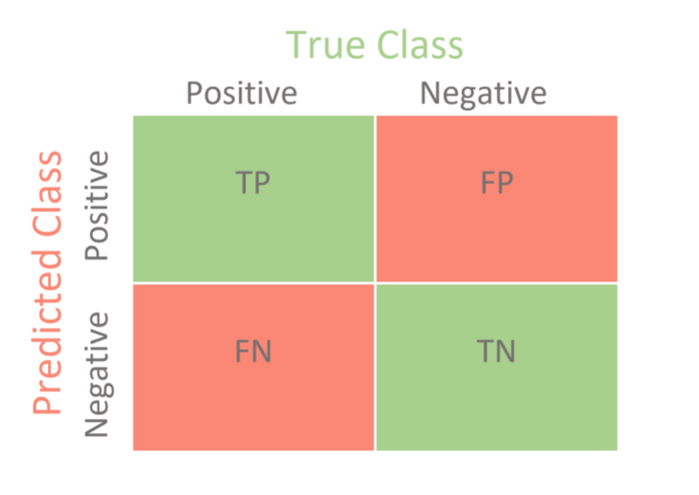
Results from second run-through
Results of second run through with the size features removed; Perimeter_mean, Perimeter_se, Perimeter_worst, Area_mean, Area_se, Area_worst, Radius_mean, Radius_se, and Radius_worst.
Accuracy Results from first ML run through:
Linear Regression = 84.27%
Logistic Regression = 97.09%
Linear Regression Results
Logistic Regression Results
Overall, a drop of 6% to our linear regression model and a drop of 4% to the logistic regression model’s accuracy.
The Logistic model had negligible changes to its precision and sensitivity, however..,
When comparing the confusion matrices, you can see 4 additional patients with false negatives (meaning they have a malignant tumor, but their results returned negative.)
And, 2 additional patients with false positives (meaning their results came back positive, but their tumor is benign.)
Logistic Regression accuracy
Notes:
David
Overall, a drop of 6% to our linear regression model and a drop of 4% to the logistic regression model’s accuracy.
The Logistic model had negligible changes to its precision and sensitivity, however..,
When comparing the confusion matrices, you can see 4 additional patients with false negatives (meaning they have a malignant tumor, but their results returned negative.)
And, 2 additional patients with false positives (meaning their results came back positive, but their tumor is benign.)

Slide 17
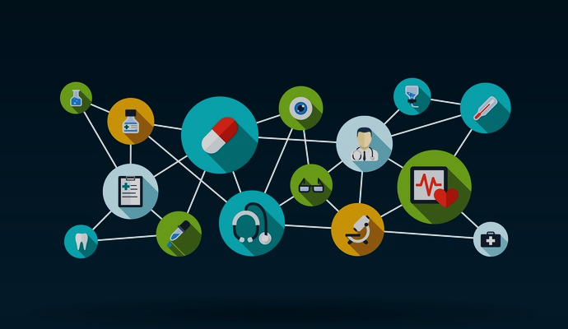
Future Recommendations:
Our ML models performed very well in both scenarios. These are our recommendations moving forward;
Remove scaling and/or oversampling and test dataset’s resilience.
Change the ratio between test data vs training data.
Try a different algorithm
Try a different dataset
Notes:
David
To summarize:
Our ML models performed very well in both scenarios. These are our recommendations moving forward;
Remove scaling and/or oversampling and test dataset’s resilience.
Change the ratio between test data vs training data.
Try a different algorithm
Try a different dataset

Slide 18

What we would have done differently
If we could do anything differently, we would have gone an extra step into exploring our data to determine what features carried more weight in determining if the sample of the cell is benign or malignant.
This would have allowed us to have more time to dive into our data the second time around when we did away with the features that describe size; we could have found another significant feature or features.
Notes:
MacKenzie
For this project, we have all agreed that we should have gone the extra step in exploring the data even more, allowing us to find which feature or features were leading our Logistic Regression accuracy score to be so high for both the models we built out.
This way, we could have informed people who look at our project in the future what types of measurements are the best at predicting whether someone has a benign or malignant tumor.

Slide 19
Questions

